Slide 1
HTTP Communication
Creating Interceptors
Lecture 3
By James(Jin) Wang
12/25/2021

Slide 2
Outline
Consuming REST services
Retrieving data with resolvers
Creating interceptors
Caching data in your apps
Unit testing

Slide 3
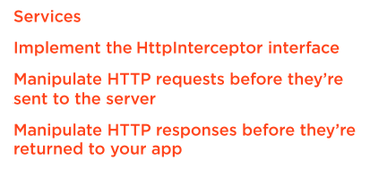
Creating Interceptors
  What are interceptors?

Slide 4
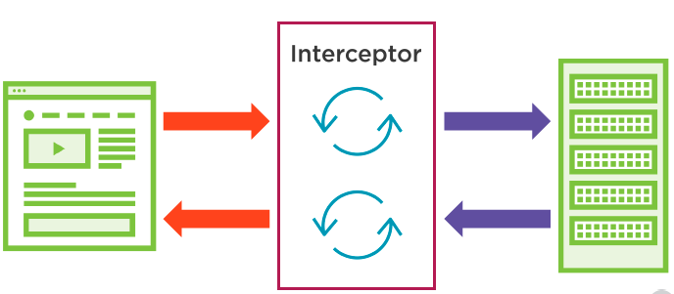
Creating Interceptors
  Intercepting Requests and Responses

Slide 5
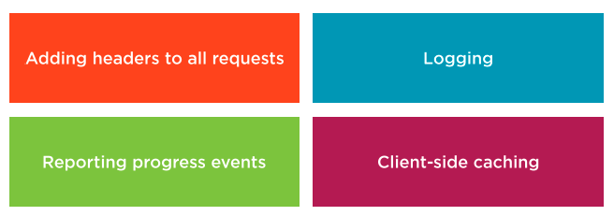
Creating Interceptors
  Uses for Interceptors

Slide 6
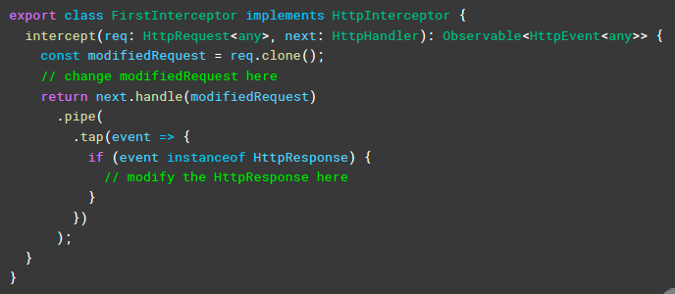
Creating Interceptors
  Defining an Interceptor

Slide 7
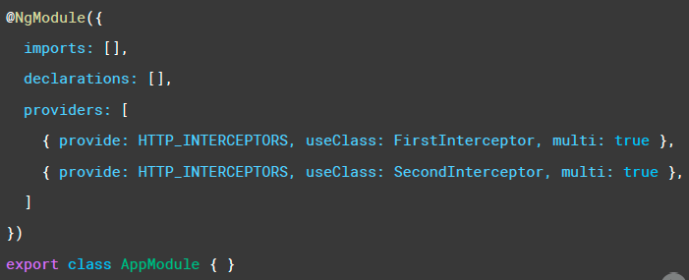
Creating Interceptors
  Providing an Interceptor

Slide 8
Creating Interceptors
  Creating an Interceptor to add headers to all requests
  Demo: create interceptor add headers to all requests

Slide 9
Creating Interceptors
  Intercepting responses and working with multiple interceptors
  Demo: intercept response and work with multiple interceptors

Slide 10
Creating Interceptors
  Configuring Interceptors

Slide 11
Summary

Slide 12
Assignment

Slide 13
Self Study
  Angular HTTP Communication
  https://app.pluralsight.com/library/courses/angular-http-communication

